Slide 1
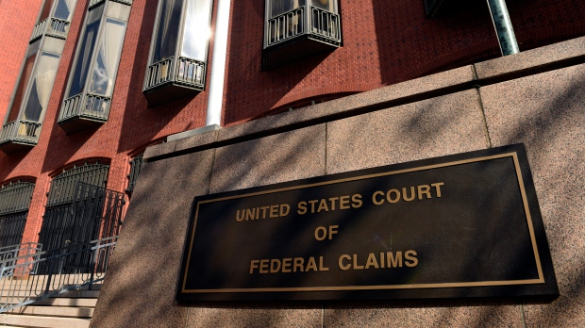
NextGen CM/ECF
United States court of federal claims
30th annual judicial conference
November 14, 2019

Slide 2
Overview
NextGen CM/ECF
What has changed?
Bar admission and E-filing registration
Maintaining filing accounts and contact information
Filing best practices
Events
Linking
Citations

Slide 3
What is NextGen CM/ECF?
Federal judiciary-wide upgrade to the electronic case filing system
The court went live on NextGen on August 26, 2019
66 courts—Appellate, District, and Bankruptcy—are currently live on NextGen

Slide 4
What has changed with NextGen CM/ECF?
Preferred web browser is Firefox
Single login and password for all NextGen courts
Attorney admission and E-filing registration through PACER
Admission fee paid through Pay.gov
E-filing account information is maintained through PACER

Slide 5
How Do Attorneys Get Access?
Existing attorneys link PACER and CM/ECF accounts
New attorneys apply for admission and e-filing through PACER
Need help?
Contact the CM/ECF Help Desk
at (202) 357-6402 or
CFC_CMECFHelpDesk@cfc.uscourts.gov

Slide 6
Filing Fees—Electronic Payments
Once you submit payment
DO NOT hit the back button
Complete the transaction
Electronic Filing Fee Refund Policy available at www.uscfc.uscourts.gov/electronic-filing
Submit a request for refund electronically using the sealed event “Request for Filing Fee Pay.gov Refund”

Slide 7
Uploading Voluminous Filings
Optimize Scanned Image
File size reduced by 50 to 90 percent
Remove
Security protections
Unnecessary hyperlinks
Divide into multiple filings (e.g., Administrative Record Part 1, Administrative Record Part 2)
Use the proper event (e.g., Administrative Record, Medical Records)

Slide 8
Bar Admission and E-Filing Registration

Slide 9
Applying for Bar Admission
Apply for admission through PACER at www.pacer.gov
By verified application or in open court – RCFC 83.1(b)
Pay the admission fee electronically through Pay.gov
A party may have only one attorney of record in a case at any one time – RCFC 83.1(c)

Slide 10
Pro Hac Vice
By motion of the attorney of record
Participation is limited to a single hearing or conference
The attorney of record in the case must be present at the hearing or conference
RCFC 83.1(a)(2)
Notes:
The court does not allow pro hac vice for general participation in a case. Attorneys of record must be admitted to the court’s bar.

Slide 11
E-Filing Registration
Register for e-filing through PACER at www.pacer.gov
New attorneys apply/register for Attorney Admissions and E-File
Attorneys already admitted and in good standing with the United States Court of Federal Claims apply for E-Filing Registration Only

Slide 12
Changes to Contact Information
E-filing account information is maintained through PACER at www.pacer.gov
Login credentials
Personal information
Contact information
Must provide prompt notice to the court of any changes to contact information – RCFC 83.1(b)(5)
Must file a notice of change of contact information in all pending cases – RCFC 83.1(c)(3)(c)

Slide 13
Filing Best Practices
Tips for cm/ecf

Slide 14
Events
Use the proper event when filing a document in CM/ECF
Use the most specific event available
Making event selection more intuitive
Streamlined lists of events
Clarification of event names

Slide 15
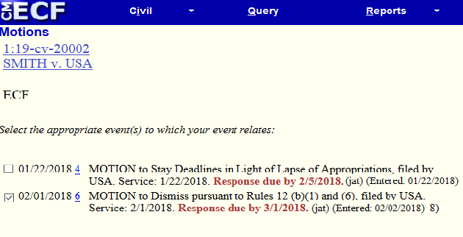
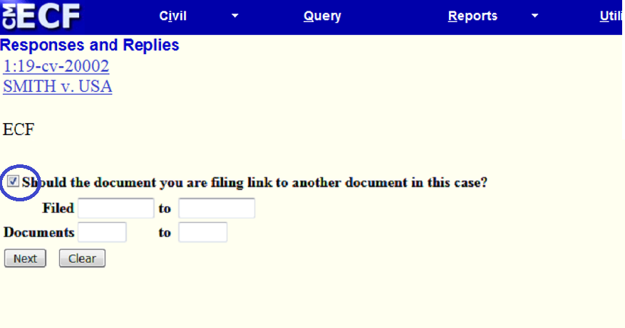
Linking
When required to link by CM/ECF, ensure that the correct event is chosen
When linking is presented as an option, always link related documents

Slide 16
Importance of Proper Filing
Using the proper event and properly linking filings
Ensures that the correct deadlines are set – helpful for running calendar reports
Allows the opposing party to properly file a response/reply to your filing
Produces a case docket that is easier to follow
Failing to use the proper event or to properly link may result in your filing being stricken from the docket
Need help with event selection or linking?
Contact the CM/ECF Help Desk at (202) 357-6402 or
CFC_CMECFHelpDesk@cfc.uscourts.gov

Slide 17
Citation Formatting
Proper citation formatting benefits parties and the court
Easier to read briefs with clear and consistent citations
Easier to locate the cited sources
Citation Links
Program for court users that adds links to citations in filed documents
Allows judges, special masters, and chambers staff to more efficiently review filed documents
Citations must be in specified formats

Slide 18
Legal Citations
For case law, statutes, regulations, and other legal sources, use standard Bluebook formats or other formats typically used by the court. For example:
Jones v. United States, 12 Fed. Cl. 45 (1987)
Doe v. United States, 123 F.2d 456 (Ct. Cl. 1941)
Smith v. Sec’y of HHS, No. 12-345V, 2019 WL 6789 (Fed. Cl. Spec. Mstr. Jan. 2, 2019)
28 U.S.C. § 1491(a)(1) (2012)
RCFC 12(b)(1); R. Ct. Fed. Cl. 12(b)(1); Vaccine Rule 8

Slide 19
Citations to Documents in CM/ECF
For documents filed with the court, include the document number (or, if the document is filed in another case, the case number and document number) in your citation
Recommended citation formats for filed documents are posted to the court’s website at http://www.uscfc.uscourts.gov/cmecf_filing_tips

Slide 20
Resources
Visit the court’s website at www.uscfc.uscourts.gov/electronic-filing for more information
NextGen
Electronic Filing Fee Refund Policy
E-filing Registration
Attorney Admissions
CM/ECF Filing Tips
Linking Filings
Citation Formats

Slide 21
Questions?

