Slide 1
Realities of Takings Litigation
Dave Owen
UC Hastings
owendave@uchastings.edu

Slide 2
Overview
Conventional views of takings litigation
Methods
What I found
By the numbers
Qualitative observations
Why lower-court takings litigation differs, in some ways, from conventional views
Implications

Slide 3
Conventional Expectations for Takings Litigation:

Slide 4
Expectation 1: Regulatory takings cases will predominate, and most will be resolved under the Penn Central standard.

Slide 5
Expectation 1: Regulatory takings cases will predominate, and most will be resolved under the Penn Central standard.
“[P]hysical appropriations are relatively rare [and] easily identified.”
Tahoe-Sierra Preservation Council v. Tahoe Regional Planning Authority, 535 U.S. 302, 324 (2002).
“Without any question, the most important case interpreting the Fifth Amendment’s Takings Clause is Penn Central Transportation Co. v. New York City.”
Christopher Serkin, Penn Central Take Two, 92 Notre Dame L. Rev. 913, 913 (2017)
“Courts subject the majority of takings claims… to a Penn Central inquiry. . . .”
Mark Fenster, Takings Formalism and Regulatory Formulas: Exactions and the Consequences of Clarity, 92 Cal. L. Rev. 609, 612 (2004).

Slide 6
Expectation 2: Most of the confusion, and most of the interesting questions, will arise in regulatory takings cases.

Slide 7
Expectation 2: Most of the confusion, and most of the interesting questions, will arise in regulatory takings cases.
Our jurisprudence involving condemnations and physical takings . . . for the most part, involves the straightforward application of per se rules. Our regulatory takings jurisprudence, in contrast, . . . is characterized by ‘essentially ad hoc, factual inquiries,’ Penn Central, 438 U.S., at 124, designed to allow ‘careful examination and weighing of all the relevant circumstances.’
Brown v. Legal Found. of Wash., 538 U.S. 216, 233 (2003)

Slide 8
Expectations 3A and 3B
3A: Takings litigation will involve singled-out individuals or businesses using constitutional protections to stand up to the might of the regulatory state.
3B: Takings litigation will involve moneyed, powerful interests using sympathetic courts to pad their good fortune—at public expense.

Slide 9
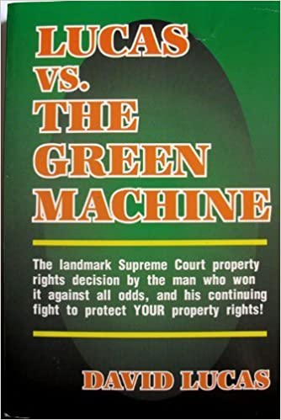
Expectations 3A and 3B
3A: Takings litigation will involve singled-out individuals or businesses using constitutional protections to stand up to the might of the regulatory state.
3B: Takings litigation will involve moneyed, powerful interests using sympathetic courts to pad their good fortune—at public expense.

Slide 10
Expectation 4: Takings litigation plays an important role in resolving conflicts between collective regulation and individual liberty.

Slide 11
Research Methodology

Slide 12
Research Methodology
Searched Bloomberg for dockets for all takings cases filed in the Court of Federal Claims between 2000 and 2014.
Search produced over 800 dockets (but some cases involved multiple dockets).

Slide 13
Research Methodology
Searched Bloomberg for dockets for all takings cases filed in the Court of Federal Claims between 2000 and 2014.
Search produced over 800 dockets (but some cases involved multiple dockets).
Reviewed documents for each case (including settlements obtained through FOIA requests) to figure out:
Subject matter
Parties and plaintiffs’ attorneys
Issues raised
Outcomes

Slide 14
Methodological Limitations
Incomplete documentation
Challenges of classification
Challenges of counting

Slide 15
Key Findings

Slide 16
Category of Case | Number of Cases
Rails-to-trails conversions | 108
Mining regulation | 44
Flooding allegedly caused by government infrastructure | 35
Water rights | 19
General public lands | 19
Military overflights | 14
Regulatory permitting | 14
Erosion or avulsion allegedly caused by government action | 13
Intellectual property | 12
Government management of financially distressed companies | 11
Military operations (non-overflight) | 11
Contaminated site cleanup | 10
Seizure or civil forfeiture associated with prosecutorial action | 10
Agricultural price program regulation | 7
Extinguishment of claims against foreign sovereigns | 7
Air traffic regulation | 7
Contract breach | 7
Tribal resources | 6
Forest fire damage | 6
Unauthorized maintenance of air traffic control towers | 5
Food safety regulation | 4
Other | 69
Unclear | 27

Slide 17
Category of Case | Number of Cases
Rails-to-trails conversions | 108
Mining regulation | 44
Flooding allegedly caused by government infrastructure | 35
Water rights | 19
General public lands | 19
Military overflights | 14
Regulatory permitting | 14
Erosion or avulsion allegedly caused by government action | 13
Intellectual property | 12
Government management of financially distressed companies | 11
Military operations (non-overflight) | 11
Contaminated site cleanup | 10
Seizure or civil forfeiture associated with prosecutorial action | 10
Agricultural price program regulation | 7
Extinguishment of claims against foreign sovereigns | 7
Air traffic regulation | 7
Contract breach | 7
Tribal resources | 6
Forest fire damage | 6
Unauthorized maintenance of air traffic control towers | 5
Food safety regulation | 4
Other | 69
Unclear | 27

Slide 18
Numbers of plaintiffs by case type.

Slide 19
Just compensation by case type.
Total just compensation payments were $453,058,985.

Slide 20
Category | Plaintiffs’ success rate | Average just compensation for successful plaintiffs (in 2020 dollars)
rails to trails | 0.65 | 88,203
other | 0.04 | 240,582
mining | 0.01 | 2,990,684
flooding | 0.06 | 1,901,047
water rights | 0.00 | NA
general public lands | 0.00 | NA
military overflights | 0.97 | 16,172
erosion/avulsion | 0.80 | 46,041
regulatory permitting | 0.19 | 4,798,595
intellectual property | 0.00 | NA
military operations (non-overflight) | 0.12 | 996,115

Slide 21
Category | Plaintiffs’ success rate | Average just compensation for successful plaintiffs (in 2020 dollars)
rails to trails | 0.65 | 88,203
other | 0.04 | 240,582
mining | 0.01 | 2,990,684
flooding | 0.06 | 1,901,047
water rights | 0.00 | NA
general public lands | 0.00 | NA
military overflights | 0.97 | 16,172
erosion/avulsion | 0.80 | 46,041
regulatory permitting | 0.19 | 4,798,595
intellectual property | 0.00 | NA
military operations (non-overflight) | 0.12 | 996,115

Slide 22
Who Is Involved?

Slide 23
The Plaintiffs
Who are they?
Average case: 24 plaintiffs
Average successful case: 77 plaintiffs
Plaintiffs generally include individuals, families, businesses, some non-profit organizations, local governments, and states.

Slide 24
The Plaintiffs
Who are they?
Who isn’t involved?
Average case: 24 plaintiffs
Average successful case: 77 plaintiffs
Plaintiffs generally include individuals, families, businesses, some non-profit organizations, local governments, and states.
Fortune 1000 (or 500) companies

Slide 25
Law Firms:
Law Firm Type | Nationally ranked | Regionally ranked | Not ranked | Pro se
Cases Handled | 75 | 96 | 309 | 77
Plaintiffs Represented | 1124 | 4949 | 9172 | 84
Rankings from Chambers USA

Slide 26
Agency | Number of cases
Surface Transportation Board | 108
US Army Corps of Engineers | 62
Dept. of the Interior Bureau of Land Management Office of Surface Mining Bureau of Reclamation Fish and Wildlife Service Bureau of Indian Affairs National Park Service BOEMRE | 61 19 10 8 7 5 4 1
Dept. of Ag. Forest Service Farmers’ Home Administration Natural Resource Conservation Service Farm Services Administration | 56 28 18 2 1
Dept. of Defense (excluding Army Corps) | 38
Federal Aviation Administration | 11
Many other agencies were involved in fewer than ten cases.

Slide 27
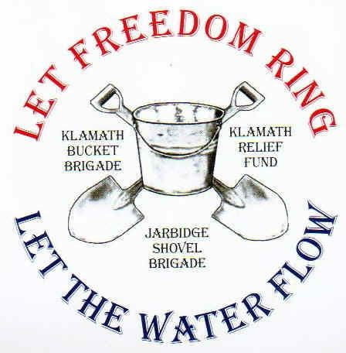
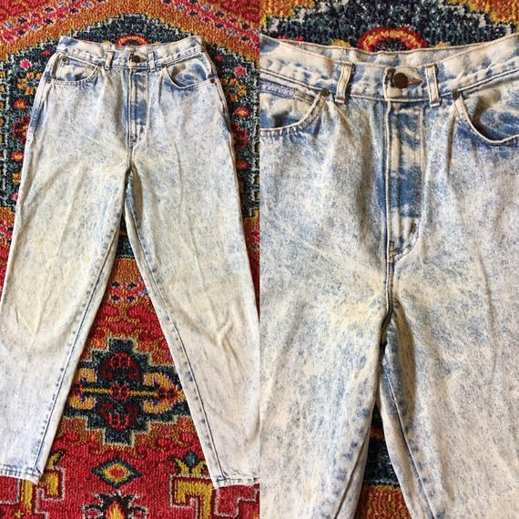
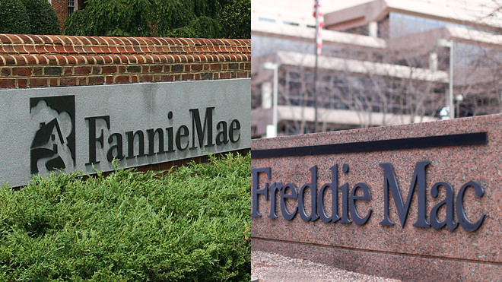
A Closer Look at Specific Areas of Takings Litigation

Slide 28
Rails to Trails
Image from railstotrails.org, courtesy of the Bucks County Planning Commission

Slide 29
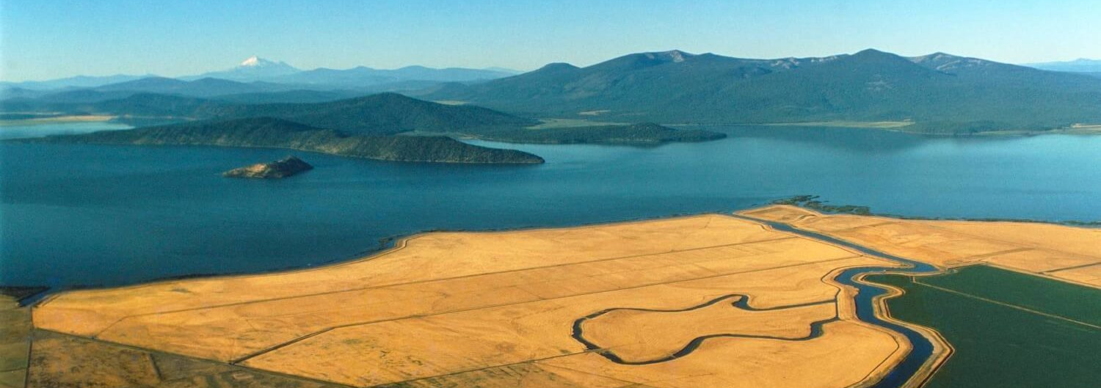
Water Rights and Regulation
Image adapted from https://thecounter.org/klamath-basin-feds-water-allotments-drought-releases-usbr-farmers-fisheries/

Slide 30
Government Management of Companies in(or Emerging from) Crisis

Slide 31
Lessons from the specific areas:

Slide 32
Lessons from the specific areas: 1. Recurring questions about the nature and boundaries of property interests.

Slide 33
Lessons from the specific areas: 1. Recurring questions about the nature and boundaries of property interests. 2. Recurring questions about the appropriate mode of takings analysis.

Slide 34
Lessons from the specific areas: 1. Recurring questions about the nature and boundaries of property interests. 2. Recurring questions about the appropriate mode of takings analysis. 3. The eclectic mix.

Slide 35
Conventional Expectations | My Findings
Most cases will involve alleged regulatory takings.
The important doctrinal questions will arise within regulatory takings doctrine.
Singled out individuals v. regulatory bureaucracy
Moneyed, ideological plaintiffs
Takings litigation plays an important role in clashes between regulatory governance and individual liberty.

Slide 36
Conventional Expectations | My Findings
Most cases will involve alleged regulatory takings. | Most cases involve alleged physical takings.
The important doctrinal questions will arise within regulatory takings doctrine.
Singled out individuals v. regulatory bureaucracy
Moneyed, ideological plaintiffs
Takings litigation plays an important role in clashes between regulatory governance and individual liberty.

Slide 37
Conventional Expectations | My Findings
Most cases will involve alleged regulatory takings. | Most cases involve alleged physical takings.
The important doctrinal questions will arise within regulatory takings doctrine. | The most difficult questions arise in physical and regulatory takings cases.
Singled out individuals v. regulatory bureaucracy
Moneyed, ideological plaintiffs
Takings litigation plays an important role in clashes between regulatory governance and individual liberty.

Slide 38
Conventional Expectations | My Findings
Most cases will involve alleged regulatory takings. | Most cases involve alleged physical takings.
The important doctrinal questions will arise within regulatory takings doctrine. | The most difficult questions arise in physical and regulatory takings cases.
Singled out individuals v. regulatory bureaucracy | Aggregate litigation against non-regulatory actions
Moneyed, ideological plaintiffs
Takings litigation plays an important role in clashes between regulatory governance and individual liberty.

Slide 39
Conventional Expectations | My Findings
Most cases will involve alleged regulatory takings. | Most cases involve alleged physical takings.
The important doctrinal questions will arise within regulatory takings doctrine. | The most difficult questions arise in physical and regulatory takings cases.
Singled out individuals v. regulatory bureaucracy | Aggregate litigation against non-regulatory actions
Moneyed, ideological plaintiffs | Some money, some ideology, hardly any big companies
Takings litigation plays an important role in clashes between regulatory governance and individual liberty.

Slide 40
Conventional Expectations | My Findings
Most cases will involve alleged regulatory takings. | Most cases involve alleged physical takings.
The important doctrinal questions will arise within regulatory takings doctrine. | The most difficult questions arise in physical and regulatory takings cases.
Singled out individuals v. regulatory bureaucracy | Aggregate litigation against non-regulatory actions
Moneyed, ideological plaintiffs | Some money, some ideology, hardly any big companies
Takings litigation plays an important role in clashes between regulatory governance and individual liberty. | Federal-court takings litigation does not appear to play an important role in clashes between regulatory governance and individual liberty.

Slide 41
Some Important and Unresolved Questions

Slide 42
Some Important and Unresolved Questions
How different would the results be if I could study state-court takings cases?

Slide 43
Some Important and Unresolved Questions
How different would the results be if I could study state-court takings cases?
How different would the results be for different time periods?

Slide 44
Some Important and Unresolved Questions
How different would the results be if I could study state-court takings cases?
How different would the results be for different time periods?
How will recent cases like Knick and Cedar Point—and whatever comes next—change things?

